Slide 1
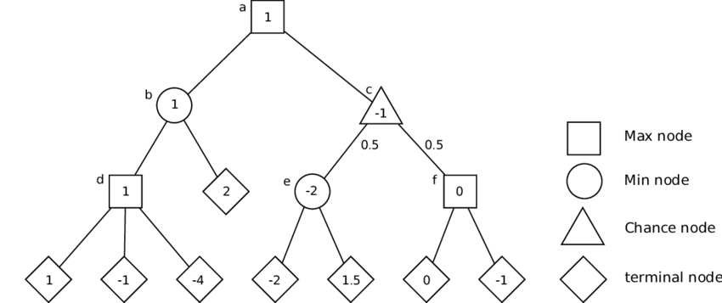
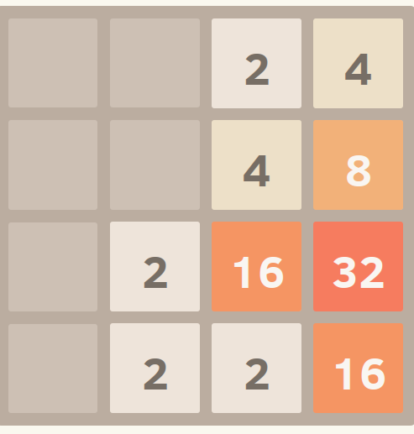
Beating 2048 With Expectimax
Christian Jahnel, Akil Dickerson, Douglas Parker, Sang Woo, Philip Roh
COMP 560

Slide 2
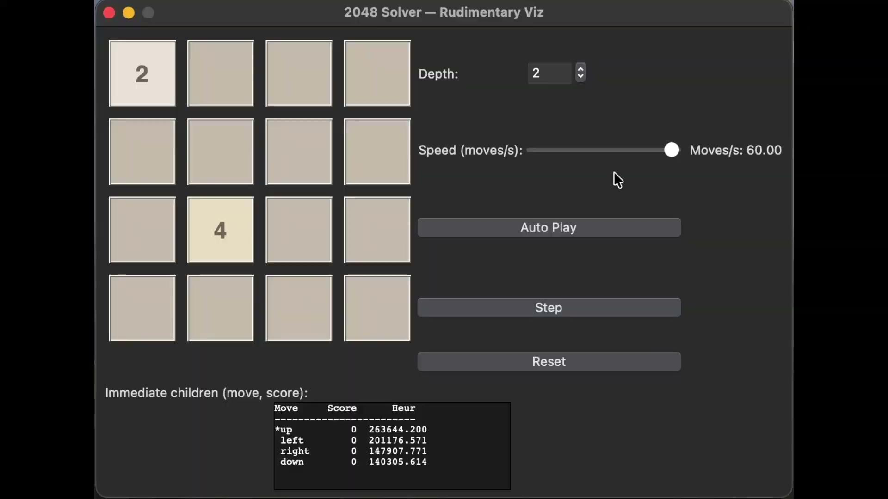
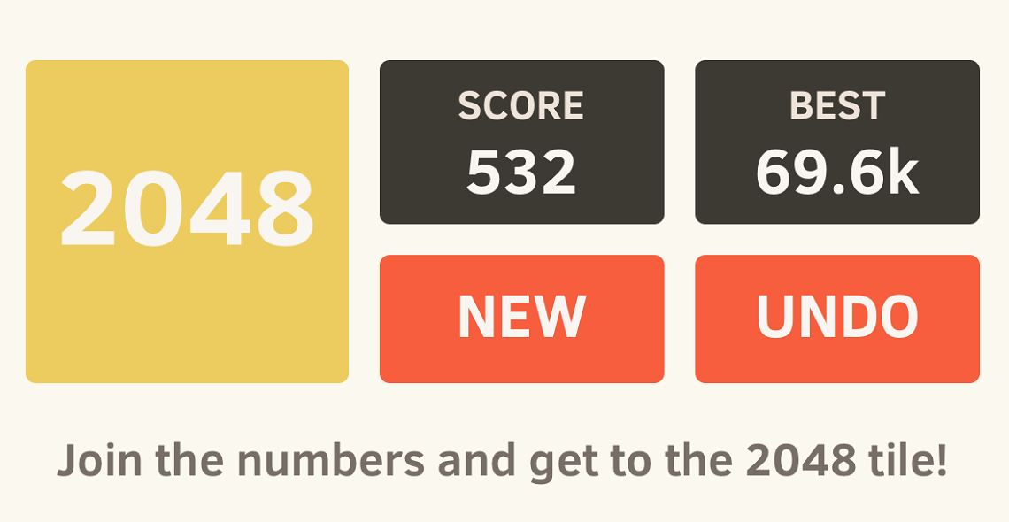
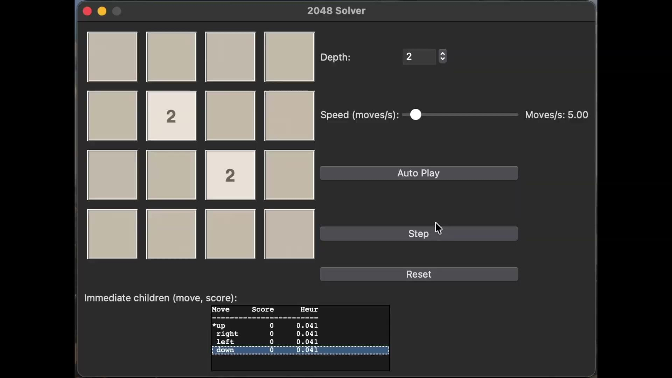
2048 is a single-player sliding tile puzzle game where the objective is to slide numbered tiles on a grid to combine them, aiming to create a tile with the value 2048. The game requires strategic movement to prevent the grid from filling up.
State: {4x4 grid of cells, Score}
Succ. Function: {Up, Left, Down, Right}
Goal State: any cell == 2048

Slide 3
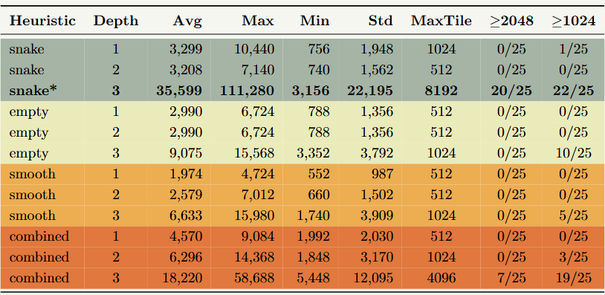
Snake Heuristic
Smooth Heuristic
Multiply a tile value by that cell's assigned weight, and add them all up. Weights are initialized in a descending “snake” pattern which rewards having a descending chain of large values in the corner.
Take every pair of tiles that are touching and calculate the absolute difference between them and subtract that from a running score. How easily can these tiles merge together right now?
w=15
w=14
w=13
w=12
v=
64
v=
32
v=
128
w=8
w=9
w=10
w=11
v=
16
w=7
w=6
w=5
w=4
Score -= |64 - 32|
Score -= |128 - 16|
w=0
w=1
w=2
w=3
Empty Heuristic
Comb. Heuristic
Count the number of empty squares on the 4x4 grid and normalize this count by dividing by 16. This represents future flexibility. Not playing to win, but to not lose on the next turn.
Normalize all three heuristics into a standard range (usually 0 to 1). Then, add them all together. Acts like a committee between all the heuristics.

Slide 4
Human vs. AI Performance
Human Performance | AI Performance
Average Score: 6304 Median Max Tile: 384 | Average Score: 8119* Median Max Tile: 768*
Analysis
Score | Max Tile
2776 | 256
10780 | 1024
3920 | 256
6792 | 512
1556 | 128
1224 | 128
1664 | 128
3200 | 256
14032 | 1024
6488 | 512
16944 | 1024
6268 | 512
Avg Score | Max Tile
3299 | 1024
3208 | 512
35599 | 8192
2990 | 512
2990 | 512
9075 | 1024
1974 | 512
2579 | 512
6633 | 1024
4570 | 512
6296 | 1024
18220 | 4096
Clearly, the models outperformed everyone in the group. But, we are unable to extrapolate this Human-AI performance comparison to the highest human performers as we couldn’t locate reliable data. With that said, this comparison still illustrates the difference in performance between the average human player of 2048 and our different heuristic-based AI models.
snake
empty
smooth
combined
*different heuristics/depths encompassed in combined statistic

